Slide 1

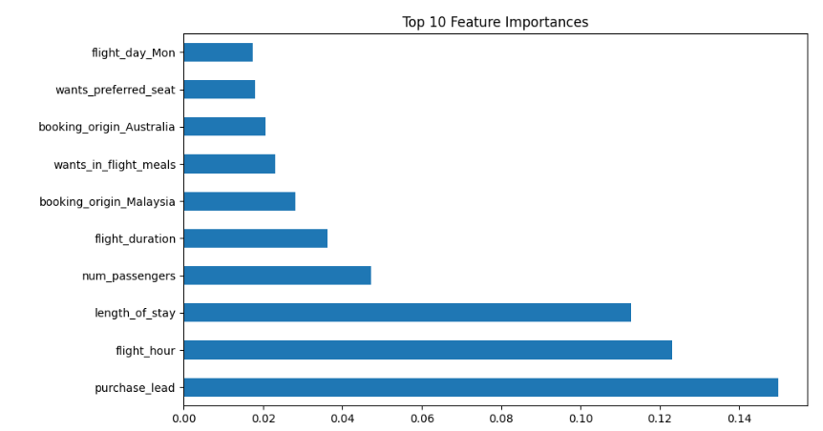
BRITISH AIRWAYS
Customer Booking Prediction Model - Insights & Findings​
Model Performance​
Accuracy: 86% (Good overall prediction power)​ Precision (Class 0 - No Booking): 87% (High precision, fewer false positives)​ Precision (Class 1 - Booking): 55% (Low precision, high false positives)​ Recall (Class 0 - No Booking): 98% (Almost all "No Bookings" predicted correctly)​
​
​
Top Features Driving Predictions:​
​ Purchase Lead: Most influential customers who book tend to plan ahead.​ Flight Hour: Time of flight significantly impacts bookings.​ Length of Stay: Longer stays are more likely to be booked.​ Number of Passengers: More passengers may indicate higher booking likelihood.​ Flight Duration: Affects decision-making for bookings.​
​
​
Key Takeaway: The model is highly effective at identifying non-booking customers these insights can help in marketing strategies targeting users based on lead time, flight time, and group booking

